Slide 1
Digital Signal Processing Lab (UEC2412)
Overlap Save and Overlap ADD Method
by
Dr. Satyakam Baraha
Assistant Professor

Slide 2
In this Lecture
DFT for linear filtering of long duration sequence
Overlap Save Method
Overlap Add Method

Slide 3
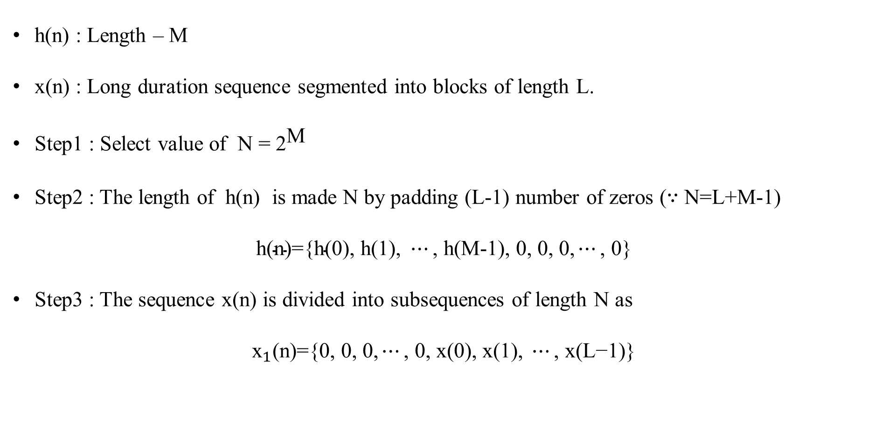
Overlap Save Method
h(n) : Length – M
x(n) : Long duration sequence segmented into blocks of length L.
Step1 : Select value of N = ${\text{2}}^{\text{M}}$
Step2 : The length of h(n) is made N by padding (L-1) number of zeros ($∵$ N=L+M-1)
$$\text{h}\text{(}\text{n}\text{)}\text{=\{}\text{h}\text{(0), }\text{h}\text{(1), }⋯\text{,} \text{h}\text{(}\text{M}\text{-1), 0, 0, 0,}⋯\text{,}\text{ 0\}}$$
Step3 : The sequence x(n) is divided into subsequences of length N as
$${\text{x}}_{1}\text{(}\text{n}\text{)=\{0,}\text{ 0, 0,}⋯\text{,}\text{ 0}\text{, }\text{x}\text{(0), }\text{x}\text{(1), }⋯\text{,} \text{x}\text{(}\text{L}\text{−1)}\text{\}}$$

Slide 4

Overlap Save Method
$${\text{x}}_{2}\text{(}\text{n}\text{)=\{}\text{x}\text{(}\text{L}\text{-}\text{M}\text{+1), }⋯\text{,} \text{x}\text{(}\text{L}\text{−1)}\text{, }\text{x}\text{(}\text{L}\text{), }\text{x}\text{(}\text{L}\text{+1),}⋯\text{,} \text{x}\text{(2}\text{L}\text{-1)\}}$$
$${\text{x}}_{3}\text{(}\text{n}\text{)=\{}\text{x}\text{(}\text{2}\text{L}\text{−}\text{M}\text{+1), }⋯\text{, }\text{x}\text{(}\text{2}\text{L}\text{−1)}\text{, }\text{x}\text{(2}\text{L}\text{), }\text{x}\text{(2}\text{L}\text{+1),}⋯\text{,} \text{x}\text{(3}\text{L}\text{−1)\}}$$
Step4 : Calculate ${\text{Y}}_{1}\text{(}\text{k}\text{)}\text{=}{\text{X}}_{1}\text{(}\text{k}\text{)} \text{H}\text{(}\text{k}\text{)}$
and ${\text{y}}_{1}\text{(}\text{n}\text{)=}\text{IDFT}\text{\{}{\text{Y}}_{1}\text{(}\text{k}\text{)}\text{\}}$
Or ${\text{y}}_{1}\text{(}\text{n}\text{)}\text{=}{\text{x}}_{1}\text{(}\text{n}\text{)} \text{⊛} \text{h}\text{(}\text{n}\text{)}$
Step5 : Repeat Step4 to obtain ${\text{y}}_{2}\text{(}\text{n}\text{)}$ and ${\text{y}}_{3}\text{(}\text{n}\text{)}$.

Slide 5

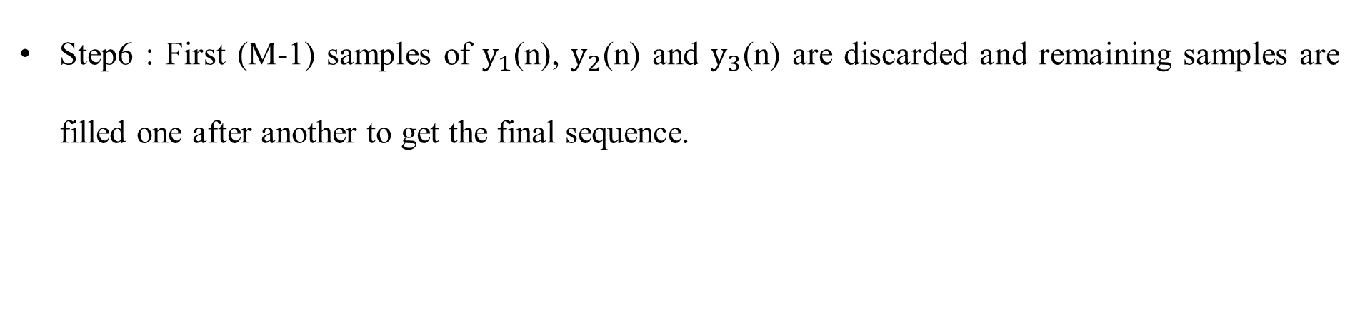
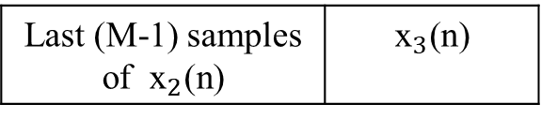
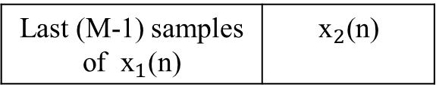

Overlap Save Method
Step6 : First (M-1) samples of ${\text{y}}_{1}\text{(}\text{n}\text{)}$, ${\text{y}}_{2}\text{(}\text{n}\text{)}$ and ${\text{y}}_{3}\text{(}\text{n}\text{)}$ are discarded and remaining samples are filled one after another to get the final sequence.
L samples
x(n) :
$${\text{x}}_{1}\text{(}\text{n}\text{)}$$ | $${\text{x}}_{2}\text{(}\text{n}\text{)}$$ | $${\text{x}}_{3}\text{(}\text{n}\text{)}$$
$$⋯$$
(M-1) zeros
L samples
$$\text{0, 0, 0,}⋯\text{, 0}$$ | $${\text{x}}_{1}\text{(}\text{n}\text{)}$$
L samples
Last (M-1) samples of ${\text{x}}_{1}\text{(}\text{n}\text{)}$ | $${\text{x}}_{2}\text{(}\text{n}\text{)}$$
L samples
Last (M-1) samples of ${\text{x}}_{2}\text{(}\text{n}\text{)}$ | $${\text{x}}_{3}\text{(}\text{n}\text{)}$$

Slide 6




Overlap Save Method
$$\text{(}\text{M}\text{-1) }\text{samples}$$ | $${\text{y}}_{1}\text{(}\text{n}\text{)}$$
(M-1) samples | $${\text{y}}_{2}\text{(}\text{n}\text{)}$$
(M-1) samples | $${\text{y}}_{3}\text{(}\text{n}\text{)}$$
y(n) :
$${\text{y}}_{1}\text{(}\text{n}\text{)}$$ | $${\text{y}}_{2}\text{(}\text{n}\text{)}$$ | $${\text{y}}_{3}\text{(}\text{n}\text{)}$$
$$⋯$$

Slide 7

Problem on Overlap Save Method
Q: Find y(n) for h(n)={1, 1, 1} and x(n)={3, -1, 0, 1, 3, 2, 0, 1, 2, 1} using overlap save method.
Solution: h(n)={1, 1, 1} Hence M = 3
Step1: N = ${\text{2}}^{\text{M}}$ = ${\text{2}}^{\text{3}}$ = 8
We know N = L+M-1 $⟹$ L = N-M+1 = 8-3+1 = 6
Step2 : Pad (L-1)=5 number of zeros to h(n).
h(n)={1, 1, 1, 0, 0, 0, 0, 0}
Step3 : ${\text{x}}_{1}\text{(}\text{n}\text{)=\{0, 0}\text{, 3, }\text{-1, 0, 1, 3, 2\}}$ and ${\text{x}}_{2}\text{(}\text{n}\text{)=\{3, 2}\text{, }\text{0, 1, 2, 1}\text{, 0, 0}\text{\}}$

Slide 8

Problem on Overlap Save Method
Step4 : ${\text{y}}_{1}\text{(}\text{n}\text{)=}{\text{x}}_{1}\text{(}\text{n}\text{)} \text{⊛} \text{h}\text{(}\text{n}\text{)}$=
0 2 3 1 0 -1 3 0 1 5
0 0 2 3 1 0 -1 3 1 2
3 0 0 2 3 1 0 -1 1 3
-1 3 0 0 2 3 1 0 0 2
0 -1 3 0 0 2 3 1 0 = 2
1 0 -1 3 0 0 2 3 0 0
3 1 0 -1 3 0 0 2 0 4
2 3 1 0 -1 3 0 0 0 6
${\text{y}}_{1}\text{(}\text{n}\text{)=}${5, 2, 3, 2, 2, 0, 4, 6}

Slide 9

Problem on Overlap Save Method
Step5 : ${\text{y}}_{2}\text{(}\text{n}\text{)=}{\text{x}}_{2}\text{(}\text{n}\text{)} \text{⊛} \text{h}\text{(}\text{n}\text{)}$=
3 0 0 1 2 1 0 2 1 3
2 3 0 0 1 2 1 0 1 5
0 2 3 0 0 1 2 1 1 5
1 0 2 3 0 0 1 2 0 3
2 1 0 2 3 0 0 1 0 = 3
1 2 1 0 2 3 0 0 0 4
0 1 2 1 0 2 3 0 0 3
0 0 1 2 1 0 2 3 0 1
${\text{y}}_{2}\text{(}\text{n}\text{)=}${3, 5, 5, 3, 3, 4, 3, 1}

Slide 10
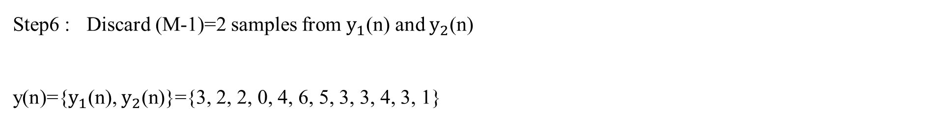
Problem on Overlap Save Method
Step6 : Discard (M-1)=2 samples from ${\text{y}}_{1}\text{(}\text{n}\text{)}$ and ${\text{y}}_{2}\text{(}\text{n}\text{)}$
y(n)={${\text{y}}_{1}\text{(}\text{n}\text{),} {\text{y}}_{2}\text{(}\text{n}\text{)\}=}${3, 2, 2, 0, 4, 6, 5, 3, 3, 4, 3, 1}

Slide 11
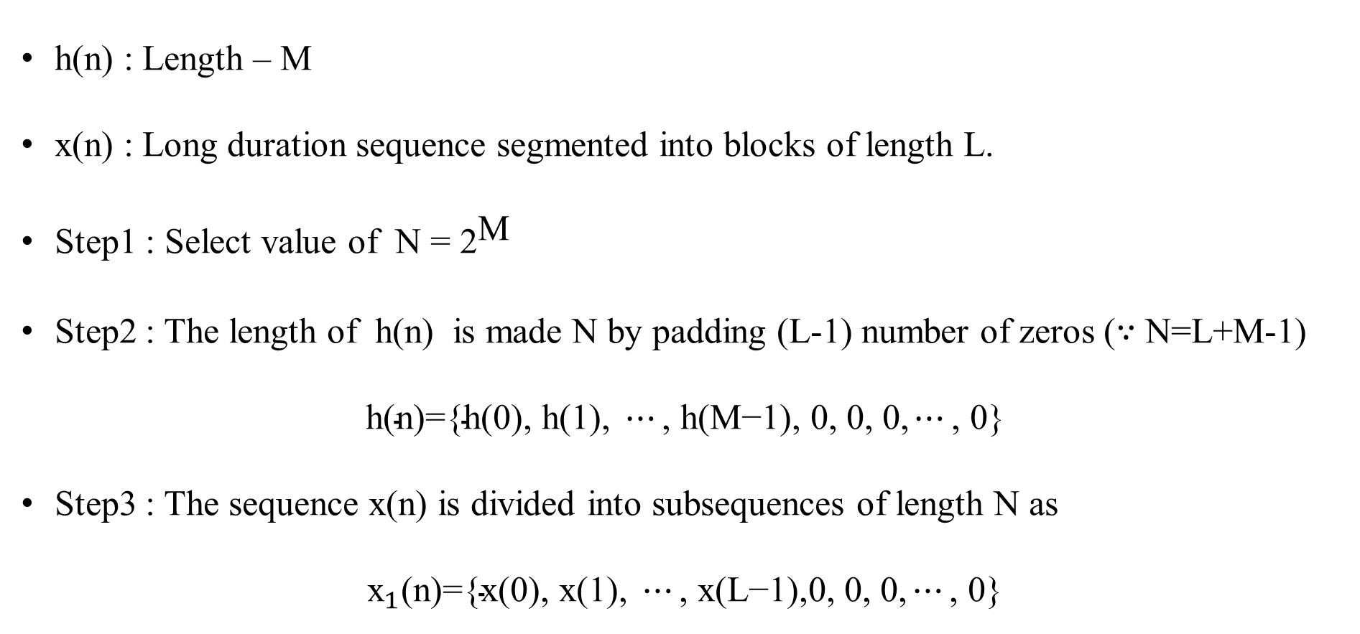
Overlap ADD Method
h(n) : Length – M
x(n) : Long duration sequence segmented into blocks of length L.
Step1 : Select value of N = ${\text{2}}^{\text{M}}$
Step2 : The length of h(n) is made N by padding (L-1) number of zeros ($∵$ N=L+M-1)
$$\text{h}\text{(}\text{n}\text{)}\text{=\{}\text{h}\text{(0), }\text{h}\text{(1), }⋯\text{,} \text{h}\text{(}\text{M}\text{−1), 0, 0, 0,}⋯\text{,}\text{ 0\}}$$
Step3 : The sequence x(n) is divided into subsequences of length N as
$${\text{x}}_{1}\text{(}\text{n}\text{)=\{}\text{x}\text{(0), }\text{x}\text{(1), }⋯\text{, }\text{x}\text{(}\text{L}\text{−1)}\text{,}\text{0, 0, 0,}⋯\text{, 0}\text{\}}$$

Slide 12

Overlap ADD Method
$${\text{x}}_{2}\text{(}\text{n}\text{)=\{}\text{x}\text{(}\text{L}\text{), }\text{x}\text{(}\text{L}\text{+1),}⋯\text{,} \text{x}\text{(2}\text{L}\text{−1),0, 0, 0,}⋯\text{, 0}\text{\}}$$
$${\text{x}}_{3}\text{(}\text{n}\text{)=\{}\text{x}\text{(2}\text{L}\text{), }\text{x}\text{(2}\text{L}\text{+1),}⋯\text{, }\text{x}\text{(3}\text{L}\text{−1),0, 0, 0,}⋯\text{, 0\}}$$
Step4 : Calculate ${\text{Y}}_{1}\text{(}\text{k}\text{)}\text{=}{\text{X}}_{1}\text{(}\text{k}\text{) }\text{H}\text{(}\text{k}\text{)}$
and ${\text{y}}_{1}\text{(}\text{n}\text{)=}\text{IDFT}\text{\{}{\text{Y}}_{1}\text{(}\text{k}\text{)\}}$
Or ${\text{y}}_{1}\text{(}\text{n}\text{)=}{\text{x}}_{1}\text{(}\text{n}\text{)} \text{⊛} \text{h}\text{(}\text{n}\text{)}$
Step5 : Repeat Step4 to obtain ${\text{y}}_{2}\text{(}\text{n}\text{)}$ and ${\text{y}}_{3}\text{(}\text{n}\text{)}$.

Slide 13




Overlap ADD Method
Step6 : Add all (M-1) samples of each output sequence to first (M-1) samples of succeeding output sequence. Such sequences are fitted one after another to get the final sequence.
L samples
x(n) :
$${\text{x}}_{1}\text{(}\text{n}\text{)}$$ | $${\text{x}}_{2}\text{(}\text{n}\text{)}$$ | $${\text{x}}_{3}\text{(}\text{n}\text{)}$$
$$⋯$$
${\text{x}}_{1}\text{(}\text{n}\text{)}$ :
 | (M-1) zeros
${\text{x}}_{2}\text{(}\text{n}\text{)}$ :
 | (M-1) zeros
${\text{x}}_{3}\text{(}\text{n}\text{)}$ :
 | $$\text{(}\text{M}\text{-1) }\text{zeros}$$

Slide 14



Overlap ADD Method
${\text{y}}_{1}\text{(}\text{n}\text{)}$ :
 | (M-1) samples
+
${\text{y}}_{2}\text{(}\text{n}\text{)}$ :
(M-1) samples |  | M-1 Samples
+
${\text{y}}_{3}\text{(}\text{n}\text{)}$ :
M-1 Samples |  | M-1 Samples
y(n) :

Slide 15
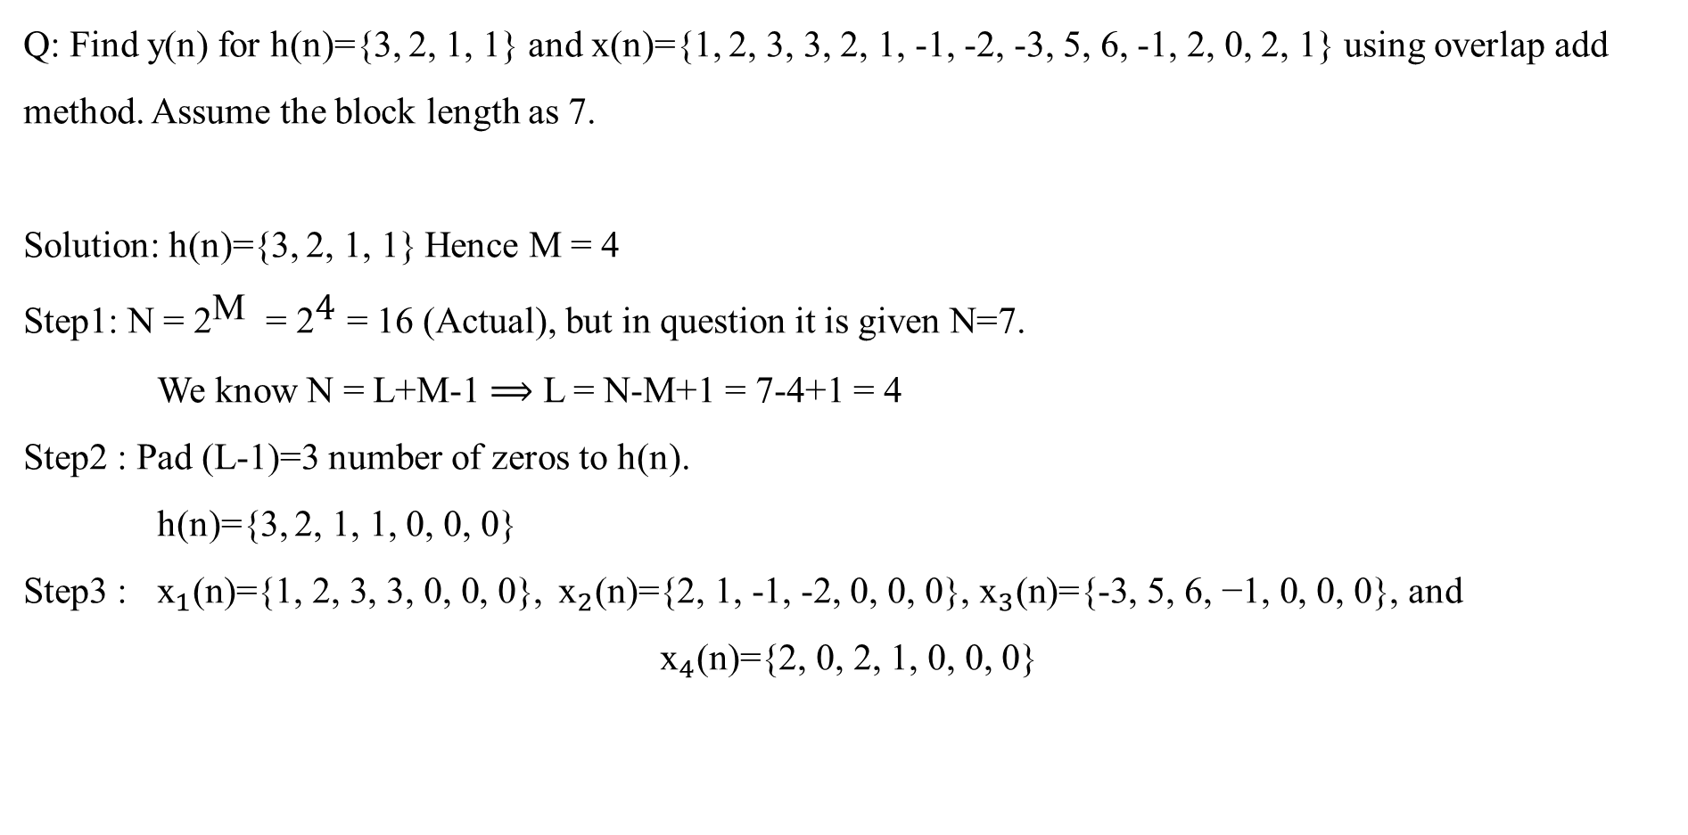
Problem on Overlap Add Method
Q: Find y(n) for h(n)={3, 2, 1, 1} and x(n)={1, 2, 3, 3, 2, 1, -1, -2, -3, 5, 6, -1, 2, 0, 2, 1} using overlap add method. Assume the block length as 7.
Solution: h(n)={3, 2, 1, 1} Hence M = 4
Step1: N = ${\text{2}}^{\text{M}}$ = ${\text{2}}^{\text{4}}$ = 16 (Actual), but in question it is given N=7.
We know N = L+M-1 $⟹$ L = N-M+1 = 7-4+1 = 4
Step2 : Pad (L-1)=3 number of zeros to h(n).
h(n)={3, 2, 1, 1, 0, 0, 0}
Step3 : ${\text{x}}_{1}\text{(}\text{n}\text{)=\{1,}\text{ 2, 3, 3, 0,}\text{ 0, 0\}}$, ${\text{x}}_{2}\text{(}\text{n}\text{)=\{2, 1}\text{, -1, -2, 0, 0, 0}\text{\}}$, ${\text{x}}_{3}\text{(}\text{n}\text{)=\{-3, }\text{5}\text{, }\text{6, }\text{−1}\text{, }\text{0, 0, 0}\text{\}}$, and
$${\text{x}}_{4}\text{(}\text{n}\text{)=\{2, 0}\text{, }\text{2}\text{, }\text{1}\text{, }\text{0, 0, 0}\text{\}}$$

Slide 16

Problem on Overlap Add Method
Step4 : ${\text{y}}_{1}\text{(}\text{n}\text{)} \text{=} {\text{x}}_{1}\text{(}\text{n}\text{)} \text{⊛} \text{h}\text{(}\text{n}\text{)}$ = {3, 8, 14, 18, 11, 6, 3}
Step5 : ${\text{y}}_{2}\text{(}\text{n}\text{) = }{\text{x}}_{2}\text{(}\text{n}\text{) ⊛ }\text{h}\text{(}\text{n}\text{)}$ = {6, 7, 1, -5, -4, -3, -2}
Step6 : ${\text{y}}_{3}\text{(}\text{n}\text{) = }{\text{x}}_{3}\text{(}\text{n}\text{) ⊛ }\text{h}\text{(}\text{n}\text{)}$ = {-9, 9, 25, 11, 9, 5, -1}
Step7 : ${\text{y}}_{4}\text{(}\text{n}\text{) = }{\text{x}}_{4}\text{(}\text{n}\text{) ⊛ }\text{h}\text{(}\text{n}\text{)}$ = {6, 4, 8, 9, 4, 3, 1}
Step8 : y(n)={ 3, 8, 14, 18, 17, 13, 4, -5, -13, 6, 23, 11, 15, 9, 7, 9, 4, 3, 1}

Slide 17
Thank You

